Slide 1
Data Analytics Project
Advance Queries to extract meaningful insights for a company that sales the product across the globe through online websites
This Project consist of mainly three tables of data names as
dim_customer - this table consists of 10 columns and 18485 rows
dim_products - this table consists of 11 columns and 296 rows
fact_sales - this table consists of 9 columns and 60399 rows

Slide 2
Change Over Time Trend Analysis Question (1): Sales Performance Over Time (By Year And Month)
MOHMMAD ANISH

Slide 3
SQL-TASK :- Aggregate The Data Progressively Over Time For A Month and A Year
SELECT
YEAR(order_date) AS order_year,
MONTH(order_date) AS order_month,
SUM(sales_amount) AS total_sales,
COUNT(DISTINCT customer_key) AS total_customers,
SUM(quantity) AS total_quantity
FROM fact_sales
WHERE order_date IS NOT NULL
GROUP BY YEAR(order_date), MONTH(order_date)
ORDER BY YEAR(order_date), MONTH(order_date);

Slide 4
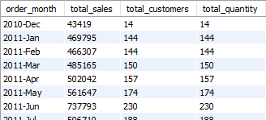
SELECT
DATE_FORMAT(order_date, '%Y-%b') AS order_month,
SUM(sales_amount) AS total_sales,
COUNT(DISTINCT customer_key) AS total_customers,
SUM(quantity) AS total_quantity
FROM fact_sales
WHERE order_date IS NOT NULL
GROUP BY DATE_FORMAT(order_date, '%Y-%b'), MONTH(order_date), YEAR(order_date)
ORDER BY YEAR(order_date), MONTH(order_date);
CONCLUSION:-- Changes Over Time → A High-level Overview Insight That Helps With Strategic Decision-making.-- Changes Over Time By Month → Detailed Insights To Discover Seasonality In Your Data.
And 38 rows counting

Slide 5
Cumulative Analysis Question- 2: Aggregate The Data Progressively Over Time Help To Understand Our Business Is Growing Or Declining
MOHMMAD ANISH

Slide 6
SQL-TASK:- -- calculate the total sales over a month -- and the running total sales over the time
SELECT
order_month,
total_sales,
SUM(total_sales) OVER (ORDER BY order_month) AS running_total_sales,
AVG(avg_price) OVER (ORDER BY order_month ROWS BETWEEN 2 PRECEDING AND CURRENT ROW) AS moving_average_price
FROM (
SELECT
DATE_FORMAT(order_date, '%Y-%m') AS order_month, SUM(sales_amount) AS total_sales,
AVG(price) AS avg_price
FROM fact_sales
WHERE order_date IS NOT NULL
GROUP BY DATE_FORMAT(order_date, '%Y-%m')
);

Slide 7
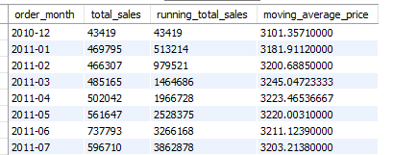
Result of the above query
And 38 rows counting

Slide 8
PERFORMANCE ANALYSIS QUESTION (3): ANALYZE YEARLY PERFORMANCE OF PRODUCTS BY COMPARING WITH
MOHMMAD ANISH

Slide 9
SQL-TASK: -- 1. AVERAGE SALES PERFORMANCE -- 2. PREVIOUS YEAR'S SALES
WITH yearly_product_sales AS (
SELECT, YEAR(f.order_date) AS order_year,
p.product_name,
SUM(f.sales_amount) AS current_sales
FROM fact_sales f
LEFT JOIN dim_products p
ON f.product_key = p.product_key
WHERE f.order_date IS NOT NULL
GROUP BY YEAR(f.order_date), p.product_name)
SELECT order_year, product_name, current_sales,
- - AVERAGE SALES PERFORMANCE
AVG(current_sales) OVER (PARTITION BY product_name) AS avg_sales,
current_sales
- AVG(current_sales) OVER (PARTITION BY product_name) AS diff_avg,
CASE WHEN current_sales - AVG(current_sales) OVER (PARTITION BY product_name) > 0 THEN 'Above Avg'
WHEN current_sales - AVG(current_sales) OVER (PARTITION BY product_name) < 0 THEN 'Below Avg'
ELSE 'Avg'
END AS avg_change,

Slide 10
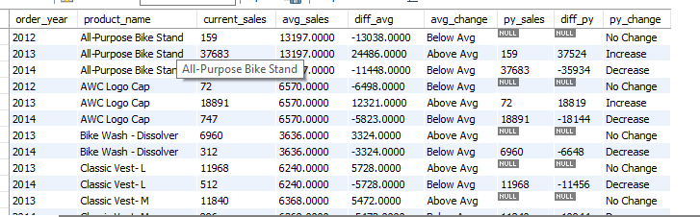
And 271 rows counting
- - YEAR-OVER-YEAR SALES COMPARISON
LAG(current_sales) OVER (PARTITION BY product_name ORDER BY order_year) AS py_sales,
current_sales - LAG(current_sales) OVER (PARTITION BY product_name
ORDER BY order_year) AS diff_py,
CASE WHEN current_sales - LAG(current_sales) OVER (PARTITION BY product_name
ORDER BY order_year) > 0 THEN 'Increase'
WHEN current_sales - LAG(current_sales) OVER (PARTITION BY product_name ORDER BY order_year) < 0 THEN 'Decrease‘
ELSE 'No Change'
END AS py_change
FROM yearly_product_sales
ORDER BY product_name, order_year;

Slide 11
PART-TO-WHOLE ANALYSIS QUESTION (4): IDENTIFY WHICH CATEGORIES CONTRIBUTE THE MOST TO OVERALL SALES

Slide 12
SQL-TASK:- Identify Which Categories Contribute The Most To Overall Sales
WITH category_sales AS (
SELECT
p.category,
SUM(f.sales_amount) AS total_sales,
COUNT(DISTINCT f.order_number) AS total_order
FROM fact_sales f
LEFT JOIN dim_products p
ON p.product_key = f.product_key
GROUP BY p.category)
SELECT category, total_sales, total_order,
SUM(total_sales) OVER () AS overall_sales,
CONCAT(ROUND((total_sales / SUM(total_sales) OVER ()) * 100, 2), '%') AS percentage_of_total_sales,
CONCAT(ROUND((total_order / SUM(total_order) OVER ()) * 100, 2), '%') AS percentage_of_total_orders
FROM category_sales;

Slide 13
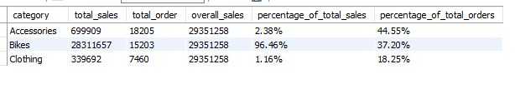
Result of the above query

Slide 14
DATA SEGMENTATION QUESTION (5): SEGMENT PRODUCTS INTO COST RANGES AND COUNT HOW MANY PRODUCTS FALL INTO EACH SEGMENT

Slide 15
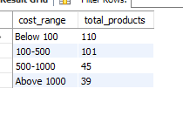
WITH product_segment AS (
SELECT product_key, product_name,
cost,
CASE WHEN cost < 100 THEN 'Below 100'
WHEN cost BETWEEN 100 AND 500 THEN '100-500'
WHEN cost BETWEEN 500 AND 1000 THEN '500-1000'
ELSE 'Above 1000'
END AS cost_range
FROM dim_products)
SELECT cost_range,
COUNT(product_key) AS total_products
FROM product_segment
GROUP BY cost_range
ORDER BY total_products DESC;

Slide 16
SQL TASK: Group Customers Into 3 Segments Based On Spending Behavior (A) VIP: At Least 12 Months Of History And Spending > $5000 (B) Regular: At Least 12 Months Of History And Spending <= $5000 (C) New: Lifespan Less Than 12 Months

Slide 17
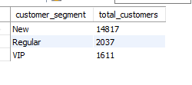
WITH customer_spending AS (
SELECT c.customer_key,
SUM(f.sales_amount) AS total_spending,
MIN(f.order_date) AS first_order,
MAX(f.order_date) AS last_order,
TIMESTAMPDIFF(MONTH, MIN(f.order_date), MAX(f.order_date)) AS lifespan
FROM fact_sales f
LEFT JOIN dim_customers c
ON f.customer_key = c.customer_key
GROUP BY c.customer_key )
SELECT customer_segment,
COUNT(customer_key) AS total_customers
FROM (
SELECT customer_key,
CASE WHEN lifespan >= 12 AND total_spending > 5000 THEN 'VIP'
WHEN lifespan >= 12 AND total_spending <= 5000 THEN 'Regular'
ELSE 'New'
END AS customer_segment
FROM customer_spending )
AS segmented_customers
GROUP BY customer_segment
ORDER BY total_customers DESC;

Slide 18
CUSTOMER REPORT
PURPOSE
THIS REPORT CONSOLIDATES KEY CUSTOMER METRICS AND BEHAVIORS HIGHLIGHTS:
1. GATHER ESSENTIAL FIELDS SUCH AS NAMES, AGES, AND TRANSACTION DETAILS.
2. SEGMENT CUSTOMERS INTO CATEGORIES (VIP, REGULAR, NEW) AND AGE GROUPS.
3. AGGREGATE CUSTOMER-LEVEL METRICS: -
TOTAL ORDERS
TOTAL SALES
TOTAL QUANTITY PURCHASED
TOTAL PRODUCTS
LIFESPAN (IN MONTHS)
4. CALCULATE VALUABLE KPIs:
RECENCY (MONTHS SINCE LAST ORDER)
AVERAGE ORDER VALUES
AVERAGE MONTHLY SPEND

Slide 19
NOTE:- The Upcoming Three Slide Are The Part Of This Final Query i.e. Report_customer
FINAL STEP: CREATE A VIEW TO BE USED FOR DASHBOARDS AND CUSTOMER INSIGHT REPORTS
CREATE VIEW report_customer AS
WITH base_query AS (
==========================================================================
1) BASE QUERY: RETRIEVE CORE COLUMNS FROM TABLES
=========================================================================
SELECT f.order_number, f.product_key, f.order_date, f.sales_amount, f.quantity, c.customer_key, c.customer_number,
CONCAT(c.first_name, ' ', c.last_name) AS customer_name,
TIMESTAMPDIFF(YEAR, c.birthdate, SYSDATE()) AS age
FROM fact_sales f
LEFT JOIN dim_customers c
ON f.customer_key = c.customer_key
WHERE f.order_date IS NOT NULL),
customer_aggregation AS

Slide 20
===============================================================================
(2) CUSTOMER AGGREGATION: SUMMARIZE KEY METRICS AT CUSTOMER LEVEL
===============================================================================
SELECT customer_key, customer_number, customer_name, age,
COUNT(DISTINCT order_number) AS total_order,
SUM(sales_amount) AS total_sales,
SUM(quantity) AS total_quantity,
COUNT(DISTINCT product_key) AS total_product,
MAX(order_date) AS last_order_date,
TIMESTAMPDIFF(MONTH, MIN(order_date), MAX(order_date)) AS lifespan
FROM base_query
GROUP BY customer_key, customer_number, customer_name, age)
SELECT customer_key, customer_number, customer_name, age,
-- AGE GROUP SEGMENTATION
CASE WHEN age < 20 THEN 'Under 20'
WHEN age BETWEEN 20 AND 29 THEN '20-29'
WHEN age BETWEEN 30 AND 39 THEN '30-39'
WHEN age BETWEEN 40 AND 49 THEN '40-49'
ELSE '50 and above'
END AS age_group,

Slide 21
===============================================================================
CUSTOMER SEGMENTATION BASED ON LIFESPAN AND SALES
===============================================================================
CASE WHEN lifespan >= 12 AND total_sales > 5000 THEN 'VIP'
WHEN lifespan >= 12 AND total_sales <= 5000 THEN 'Regular'
ELSE 'New'
END AS customer_segment,
last_order_date,
TIMESTAMPDIFF(MONTH, last_order_date, SYSDATE()) AS recency,
total_order, total_sales, total_quantity, total_product,
lifespan,
--------------------AVERAGE ORDER VALUE ------------------------------------------------------------------------------------
CASE WHEN total_order = 0 THEN 0
ELSE total_sales / total_order
END AS avg_order,
--------------------AVERAGE MONTHLY SPEND ----------------------------------------------------------------------------------
CASE WHEN lifespan = 0 THEN total_sales
ELSE CAST(total_sales / lifespan AS DECIMAL(10))
END AS avg_monthly_spend
FROM customer_aggregation;

Slide 22
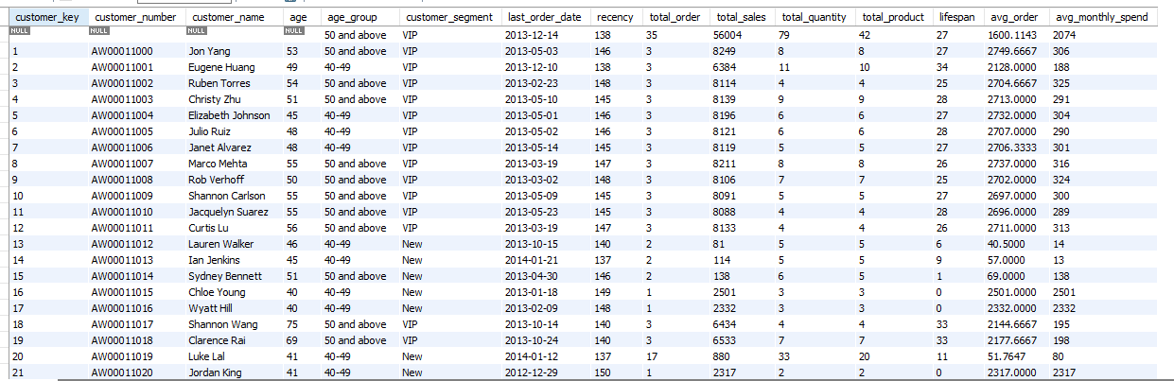
Result of the above query
And 18466 rows counting

